Slide 1
Canada Car Accident 1999 - 2014
Boris Korotkov
Chaewon Kim
Patricia Luo
Ryan He

Slide 2
Canada Car Accident 1999 - 2014
Overview
Analysis
Conclusions
Appendix

Slide 3
Overview - Data Source
Canada, 1999 – 2014, CSV from Kaggle
Collision data: Date, Time, Severity, Road condition, Weather, etc.
Vehicle data: Type, Model year
Person data: Sex, Age, Position, Treatment, Safety device, etc.
C_YEAR | C_MNTH | C_WDAY | C_HOUR | C_SEV | C_VEHS | C_CONF | C_RCFG | C_WTHR | C_RSUR | C_RALN | C_TRAF | V_ID | V_TYPE | V_YEAR | P_ID | P_SEX | P_AGE | P_PSN | P_ISEV | P_SAFE | P_USER
1999 | 1 | 1 | 20 | 2 | 2 | 34 | UU | 1 | 5 | 3 | 3 | 1 | 6 | 1990 | 1 | M | 41 | 11 | 1 | UU | 1
About 6 million registered collisions
Most are number in string
Special values: e.g., not applicable, unknown

Slide 4
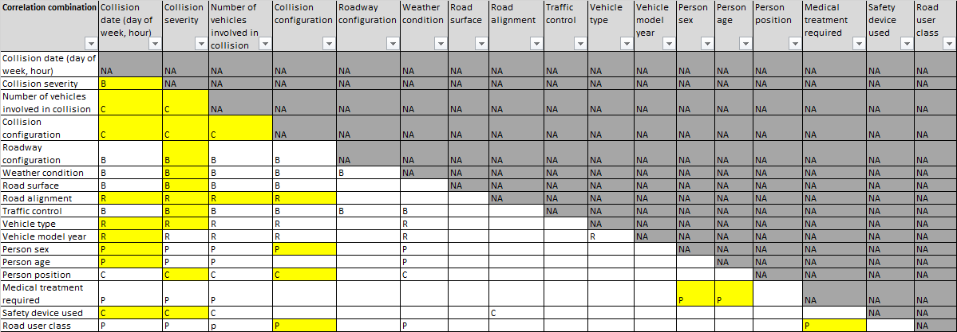
Overview - Data Loading & Preparation
Load data through pandas.read_csv, all cleanup/analysis in Python
Team analyzed all fields, each analysis covers relationship of two

Slide 5
Canada Car Accident 1999 - 2014
Overview
Analysis
Conclusions
Appendix

Slide 6
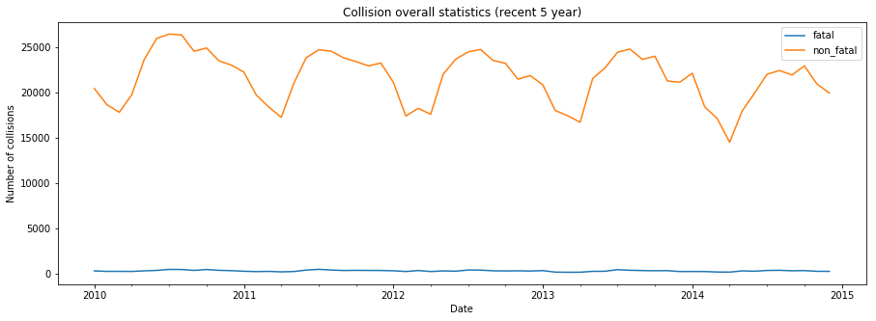
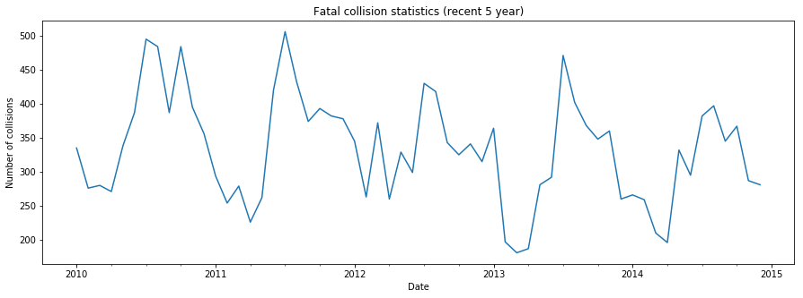
Analysis - 1. Fatal and Non-Fatal Collision

Slide 7
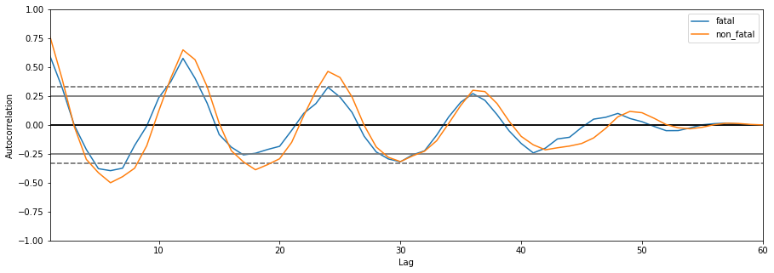
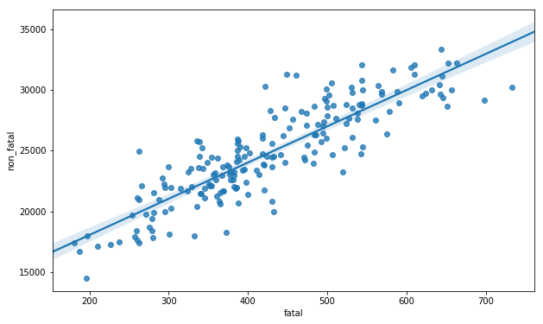
Analysis - 1. Fatal and Non-Fatal Collision

Slide 8
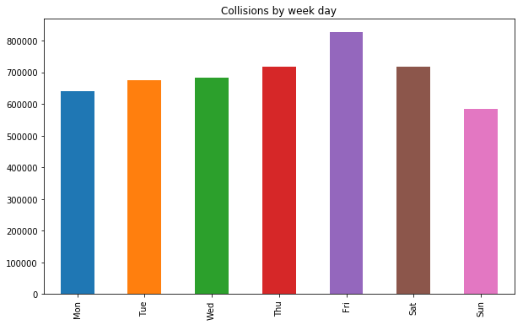
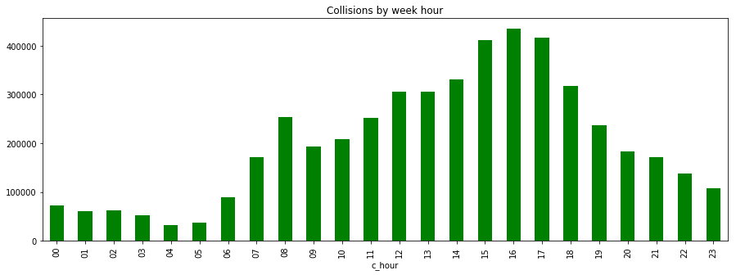
Analysis - 2. Collision Risk by Week Day and Day Hour
Day Hour
Week Day

Slide 9
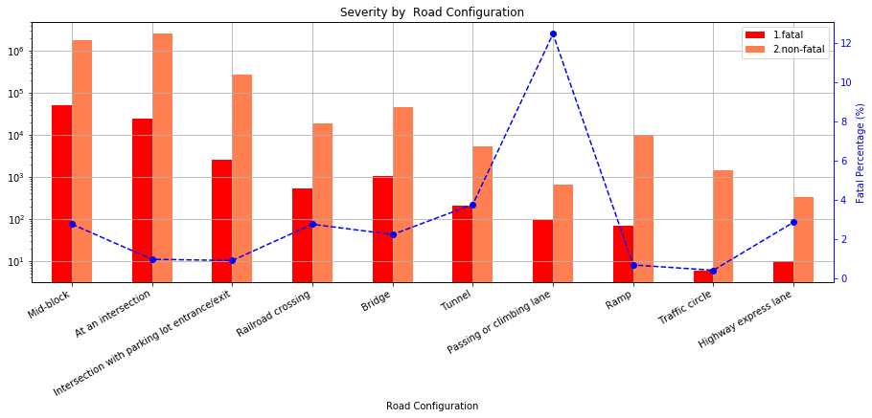
Analysis - 3. Road configuration, weather and traffic control

Slide 10
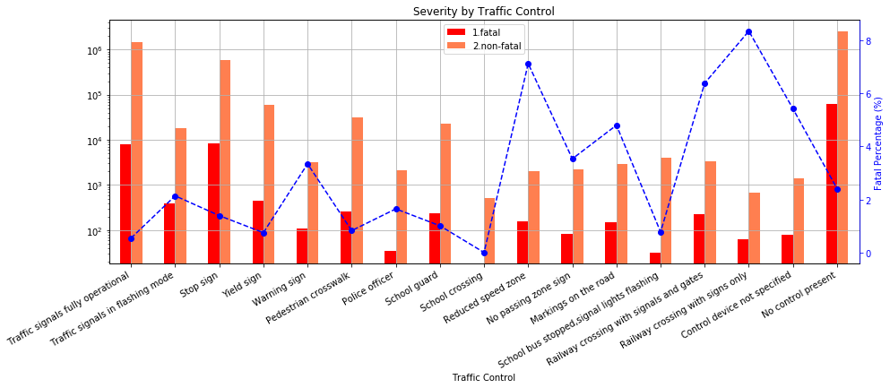
Analysis - 3. Road configuration, weather and traffic control

Slide 11
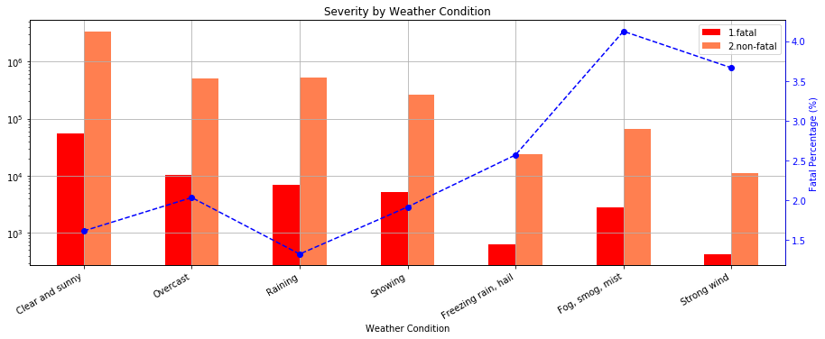
Analysis - 3. Road configuration, weather and traffic control

Slide 12
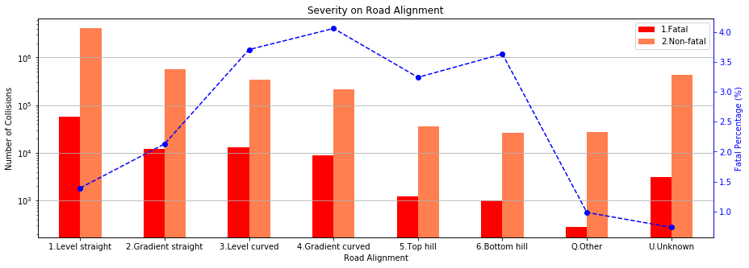
Analysis - 4. Road Alignment

Slide 13
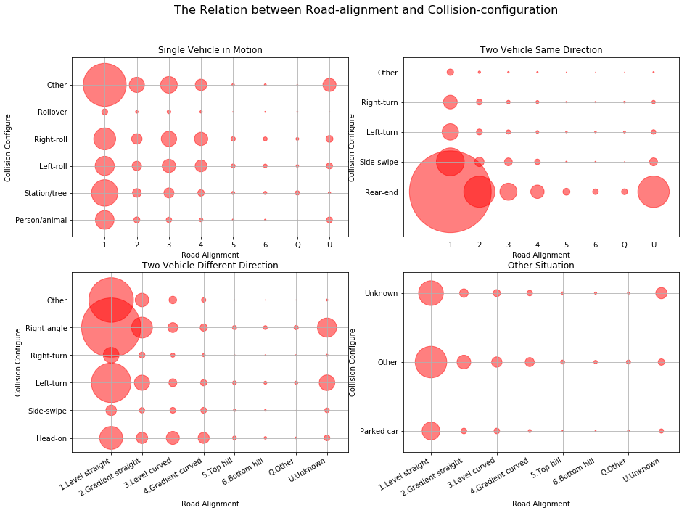
Analysis - 4. Road Alignment

Slide 14
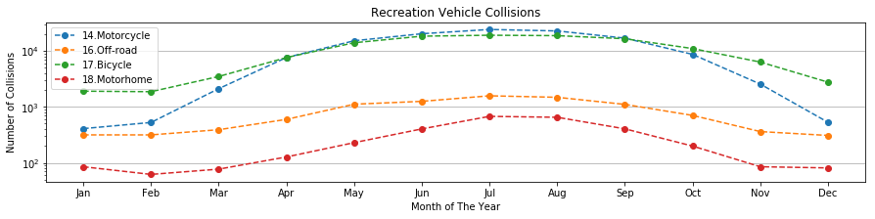
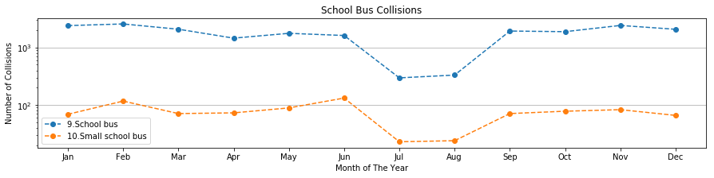
Analysis - 5. Vehicle Type

Slide 15
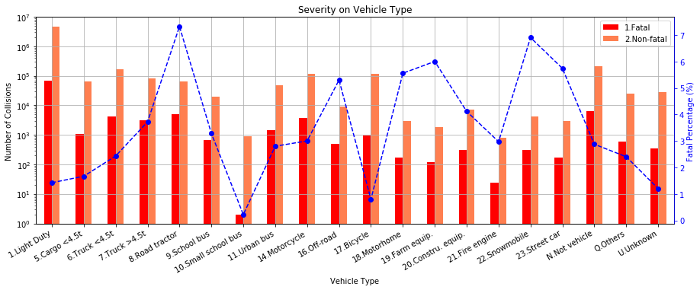
Analysis - 5. Vehicle Type & Severity

Slide 16
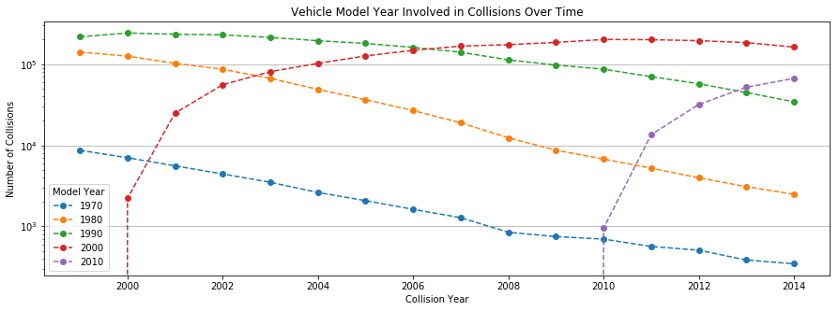
Analysis - 6. Vehicle Model Year

Slide 17
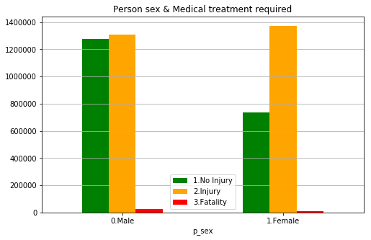
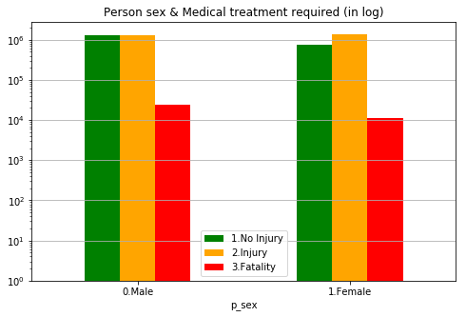
Analysis - 7. Person sex

Slide 18
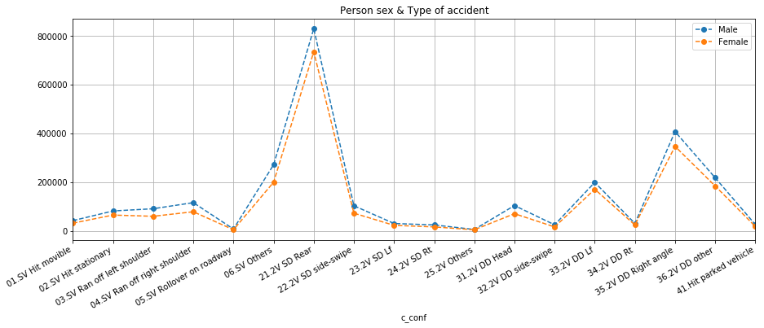
Analysis - 7. Person sex

Slide 19
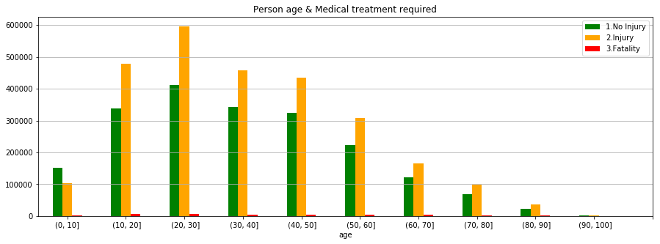
Analysis - 8. Person age

Slide 20
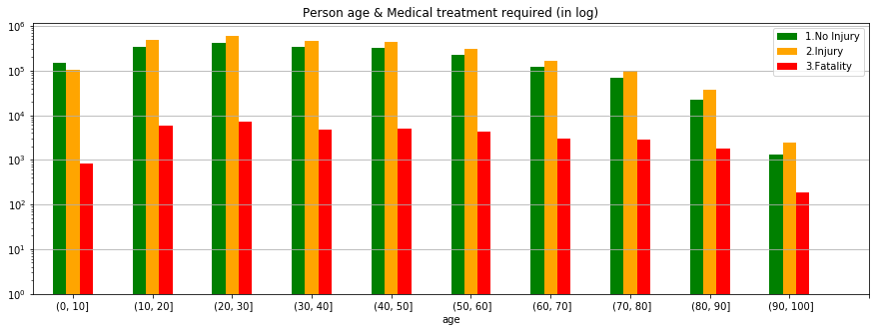
Analysis - 8. Person age

Slide 21
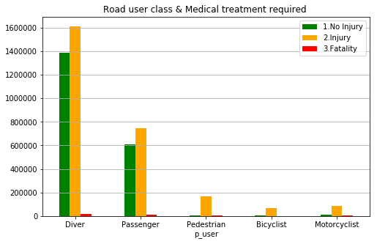
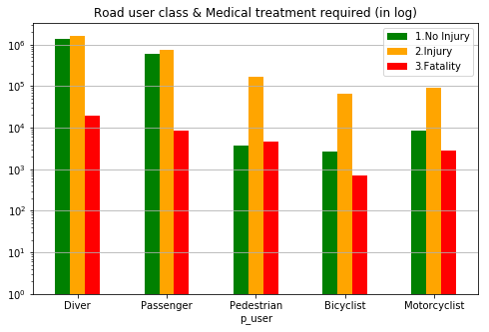
Analysis - 9. Road user class

Slide 22
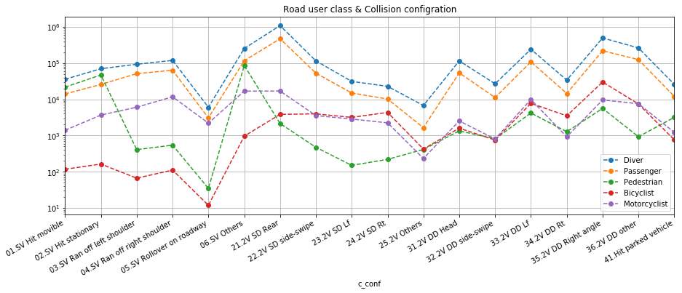
Analysis - 9. Road user class

Slide 23
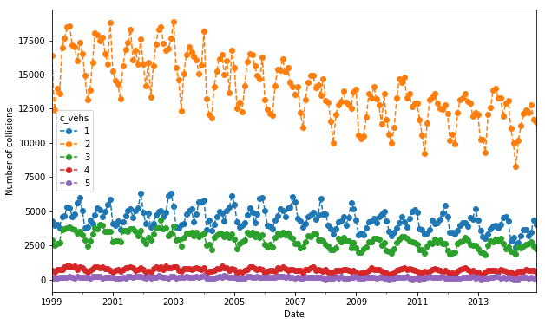
Analysis - 10. Number of Vehicles & Time relation

Slide 24
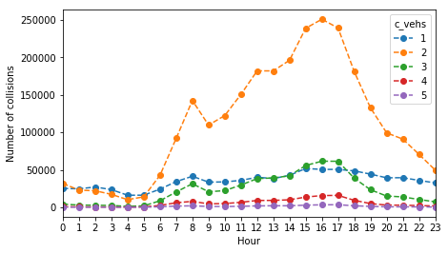
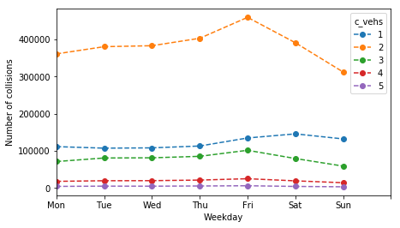
Analysis - 10. Number of Vehicles & Time relation

Slide 25
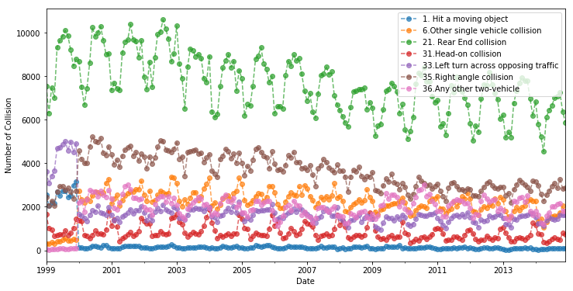
Analysis - 11. Collision Configuration

Slide 26
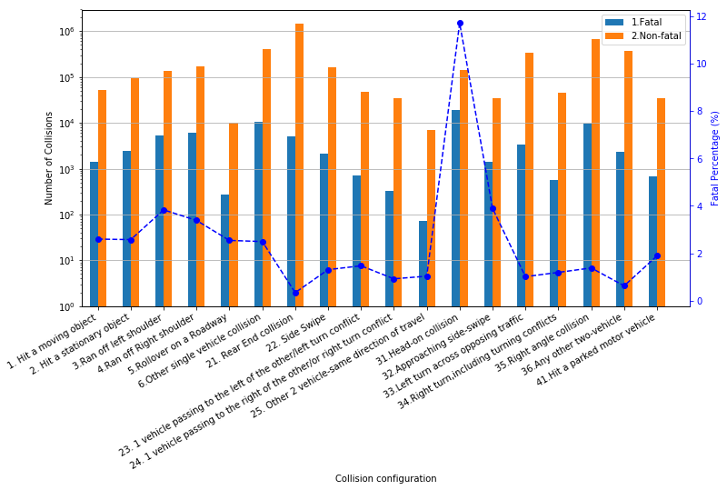
Analysis - 11. Collision Configuration

Slide 27
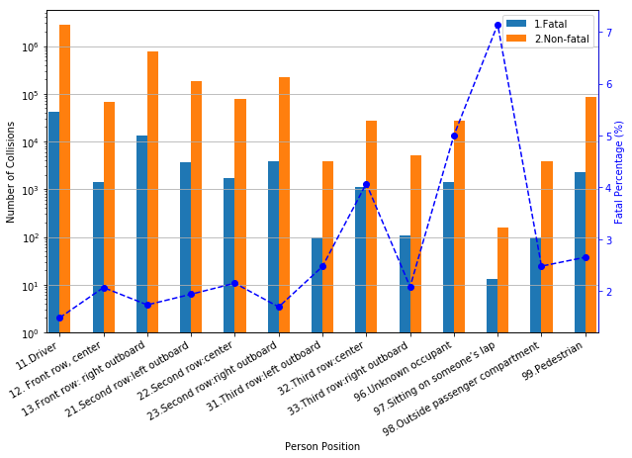
Analysis - 12. Person Position

Slide 28
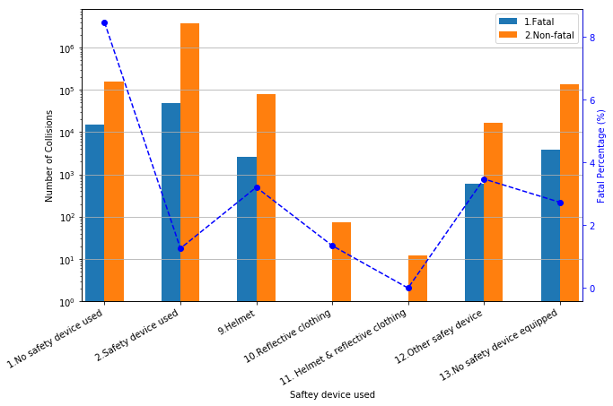
Analysis - 12. Person Position

Slide 29
Canada Car Accident 1999 - 2014
Overview
Analysis
Conclusions
Appendix

Slide 30
Conclusions - Title

Slide 31
Conclusions - Title

Slide 32
Conclusions - Title

Slide 33
Conclusions - Title

Slide 34
Canada Car Accident 1999 - 2014
Data Preparation
Analysis
Conclusions
Appendix

Slide 35
Section - Title

Slide 36

Canada Car Accident 1999 - 2014

Slide 37
Canada Car Accident 1999 - 2014
Thank You

